Slide 1

lec???Contour-finding-V1.0-2019-09-08
CTI One Corporation
Version: x0.1
Date: 09 08, 2019
Project Lead: Harry Li, Ph.D.
Team member: Prashanth Rajasekar
Company confidential
Notes:
1
1

Slide 2
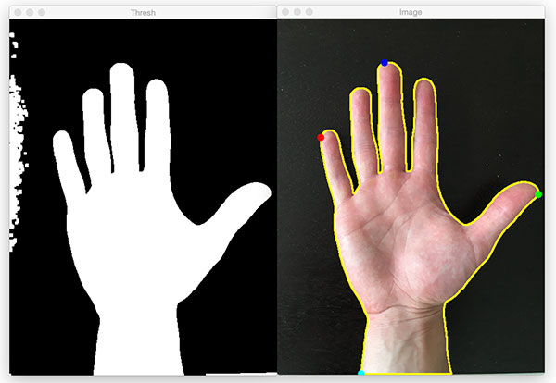
Finding contours on input image
Contours can be explained simply as a curve joining all the continuous points (along the boundary), having same color or intensity. The contours are a useful tool for shape analysis and object detection and recognition.
Using the contours we can draw the ROIs of different shapes.
Once the ROIs are drawn, the images can be clipped, used for further processing purpose.
Steps that are usually followed while doing image processing and exporting the processed images:
Read the frame from the source.
Find contours
Draw ROI/ROIs
Clip the ROIs and export to the other functions for detection or recognition purpose.
Here comes the role of Deep Learning in recognition purpose.
Notes:
2
2

Slide 3
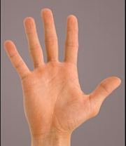
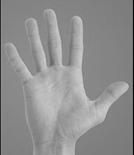
Method we followed while finding contours
Procedure:
Read the image from the Disk or webcam or any other source.
Convert the image to gray scale.
Apply thresholding(0, 255).
Apply contour finding function to locate the contours.
Grab the contours.
Sort the contours based on the ascending order. Left to right.
Push the contour corrrdinates to some list.
Using the recorded points, draw the ROI around the conrours.
Clip the image.
Save the image
Notes:
3
3

Slide 4
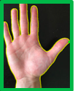
Method we followed while finding contours
Steps wise explaination:
Deep Learning recognition models
Output: It’s a hand
When this pattern is repeated in a while loop, this can be applied to continuous stream of video frames.
Notes:
4
4

Slide 5


Localizing digits for handwritten digit recognition
Numeral_detector.h5
Numeral_detector.h5
Numeral_detector.h5
Numeral_detector.h5
2
+
0
+
1
+
9
x10^3
x10^2
x10^1
x10^0
=2019
Notes:
5
5

Slide 6
Thank You
END

